Slide 1
Emoji Prediction

Slide 2
What am I learning?
Basic basic basic app for basic basic Machine Learning
Classification
Supervised Learning
Natural Language Processing

Slide 3
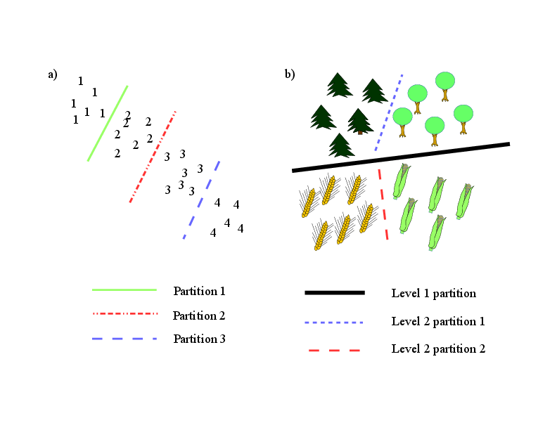
Emoji Prediction is a Classification Problem
What is a classification problem?
Statistical Classification
(Def.) In machine learning and statistics, classification is the problem of identifying to which of a set of categories (sub-populations) a new observation belongs, on the basis of a training set of data containing observations (or instances) whose category membership is known.
TLDR – Assigning a new data point to a specific group

Slide 4

Emoji Prediction is Natural Language Processing
Sweet...
(Def.) Natural language processing (NLP) is a subfield of linguistics, computer science, information engineering, and artificial intelligence concerned with the interactions between computers and human (natural) languages, in particular how to program computers to process and analyze large amounts of natural language data.
TLDR – How to make computers understand words

Slide 5
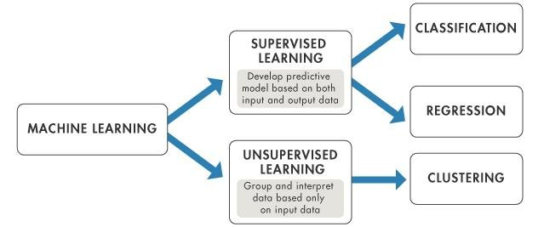
Supervised Learning
(Def.) the machine learning task of learning a function that maps an input to an output based on example input-output pairs. It infers a function from labeled training data consisting of a set of training examples.
TLDR – Giving a computer the answers

Slide 6
How???
Tools
scikit-learn
https://scikit-learn.org/stable/

